Slide 1
Adenomyosis
SIG Endocrinology 2019
Chairperson – Madhuri Patil

Slide 2
Adenomyosis
Presence of endometrial glands and stroma deep within the myometrium (>2.5 mm from EJZ)
It is a myoproliferative disease of the inner myometrium and is further characterized by an altered local paracrine and immune microenvironment
Results in local inflammation and proliferation of basal endometrium into the uterine wall
Prevalence ranging from 8 to 27%
Association between pelvic endometriosis and adenomyosis 54%
(de Souza et al, 1995) to 79- 90% (Kuntz et al, 2005)
(de Souza et al., 1995; Kunz et al., 2005, 2007; Kissler et al., 2008), Kunz et al. (2007)

Slide 3
Etiology of Adenomyosis
Trauma by chronic peristalsis and hyper peristalsis auto traumatization
Invagination of the deep basal part of endometrium in the myometrium (estrogen dependent- promotes the process)
Originates from embryological pluripotential mullerian remnants
Invagination of the basalis along the myometrial lymphatic system
From the bone marrow stem cells (displaced through the vasculature

Slide 4
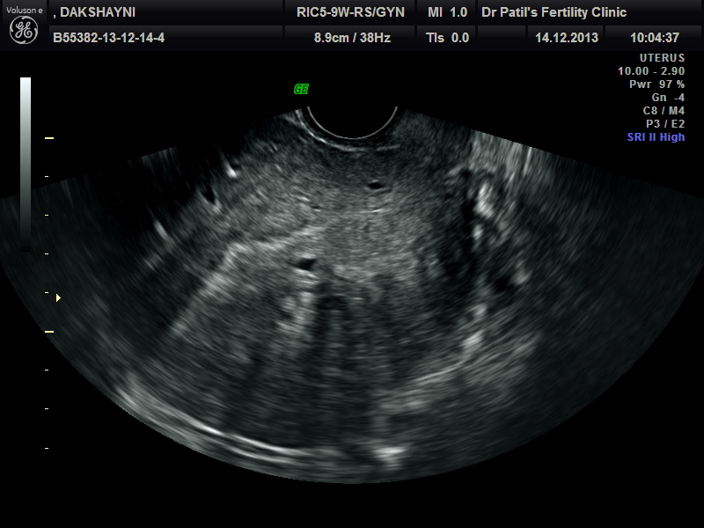
Adenomyosis
Has possible association with
subfertility
dysmenorrhea
pain
menorrhagia
early pregnancy loss

Slide 5
Characteristics To Be Used For Categorization
Anatomical characteristics
Uterine zone: outer myometrium, inner myometrium, junctional zone myometrium, endometrium
Histological characteristics
Variant: cystic, predominantly grandular/muscular, atypical
Location: anterior wall, posterior wall, fundus, lateral wall
Infiltration: depth of disease
Pattern – Diffuse, localized
Others?
– Extra‐uterine lesions (endometriosis, adhesions etc)

Slide 6
Proposed Classification of Adenomyosis
Proposed Classification | Criteria
JZ hyperplasia | JZ thickness measuring 8 mm but < 12 mm on T2-weighted images in women 35 years. Partial or diffuse
Adenomyosis | JW thickness 12 mm; high-signal intensity myometrial foci; involvement of the outer myometrium; < 1/3, < 2/3, >2/3
Adenomyoma | Myometrial mass with indistinct margins of primarily low-signal intensity on all MR sequences. Retrocervical, retrovaginal, fallopian tube and bladder types
Gordts et al, RBM Online, 17: 244‐248, 2009

Slide 7
Surgical/histological classification of adenomyosis
Diffuse adenomyosis | 1. Smooth muscle hyperplasia with ectopic endometrium (junctional zone) 2. Micro‐dilated ectopic endometrial glands throughout hyperplastic myometrium
Focal adenomyosis | Adenomyomas Cystic adult adenomyosis 2a. Juvenile cystic adenomyosis
Polypoid adenomyosis | Typical polypoid adenomyomas Atypical polypoid adenomyomas
Special categories | Adenomyomas of endocervical type Retroperitoneal adenomyosis Rectovaginal endometriosis
Grimbizis et al, Fertil Steril, 101: 472‐487, 2014

Slide 8
Four subtypes of adenomyosis assessed by magnetic resonance imaging and their specification
Subtype I: Direct endometrial invasion
Disruption of the endometrial‐myometrial barrier
Traumatic damage of the barrier (curettage)
Disruption of the barrier during normal pregnancy by the trophoblastic invasion
In nulliparous women other mechanisms could underlie to this disruption that could consequently affect implantation?
Subtype II: Endometriotic invasion from the outside
Pelvic endometriosis is the progenitor
In the absence of inner junctional zone invasion is there any additional impact on implantation and fertility potential by adenomyosis or this is the result of endometriosis?
Subtype III: De novo metaplasia?
What is the exact impact on fertility potential?
Is there a correlation with size like myomas?
Subtype IV: heterogeneous mixture of advanced stages of previous subtypes
What is the impact on fertility potential?
Kishi et al, Am J Obstet Gynecol, 2012

Slide 9
Pattern of disease
Diffuse adenomyosis
Diffuse - Mild
Diffuse -Severe

Slide 10
Pattern of disease
Focal adenomyosis
Focal adenomyosis
Adenomyoma

Slide 11
Adenomyosis and Reproduction
Proposed Staging
Stage 0
solitary junctional zone hyperplasia without infiltration myometrium
Stage 1
a focal thickening of junctional zone <20 mm
b focal thickening of junctional zone >20 mm
Stage 2
a: diffuse adenomyosis with less than 1/3 of myometrium involved
b: diffuse adenomyosis with more than 1/3 of myometrium involved
Stage 3
uterine adenomyosis and extra-uterine localization (RV, bladder)

Slide 12
Diagnosis
USG – 2D and 3D
heterogeneous myometrial area - (88% sensitivity; 75% accuracy
MRI
JZ >12mm
Focal thickening of JZ
Adenomyotic nodule
globular asymmetric uterus
myometrial linear striations with
poor definition of endometrial myometrial junction
myometrial anterior posterior asymmetry and thickening of anterior and posterior myometrial wall and increased or decreased echogenecity
irregular cystic spaces - (98% specificity; 78% accuracy)
On 3D-TVS, the best markers were JZ difference >4 mm and JZ infiltration and distortion (both 88% sensitivity; 85% and 82% accuracy, respectively

Slide 13
Spectrum of MRI findings and correlation with histology

Slide 14
Histopathology
Targeted biopsy
Endometrial glands and stroma within myometrium
Hyperplastic smooth muscle cells
Glandular extension > 2.5 mm below the endometrial – myometrial interface
Zone 1 – Myometrium seen as homogenous structure

Slide 15
At hysteroscopy subtle lesions may be diagnostic of adenomyosis
Strawberry pattern
Hypervascularisation
Localized mucosal elevation
Endometrial defects

Slide 16
Adenomyosis‐ Detrimental effect on infertility treatment Outcome
Chronic inflammation
(Tremellen and Russell‐2012)
Over expression of endometrial cP450
(Brosens et al‐2004)
Dysperistalsis
(Kissler et al‐2006)
Dysregulation myometrial architecture
Abnormal intra-myometrial metabolism
Altered function of HOX A10 gen
Alterations of adhesion molecules, cell proliferation, apoptosis, free radical metabolism
Benagiano et al‐2012, 2013)

Slide 17
Junctional zone abnormalities due to adenomyosis associated with lower Implantation rates
Excessive inner myometrium contractions have been shown to reduce implantation rates in both spontaneous and stimulated cycles
Inverse correlation between the frequency of uterine peristalsis on the day of embryo transfer and pregnancy outcome.
High-frequency endometrial waves on the day of embryo transfer appear to affect the IVF-ET outcome in a negative manner, possibly by expelling embryos from the uterine cavity

Slide 18
IVF/ET Outcomes In Relation To Myometrial Thickness
Myometrial thickening of more than 2.50 cm exerts overall adverse effects on IVF‐ET outcomes
Even with mild thickening (2.00–2.49 cm), the presence of sonographic findings suggestive of adenomyosis is associated with adverse outcomes of IVF‐ET
Hyun Sik Youm et al J Assit Reprod Genet. 2011 Sept 24

Slide 19
Management of Adenomyosis
intrauterine insertion of danazol- or Levonorgestrel loaded devices
GnRH agonist therapy
laparoscopic partial resection with uterine artery occlusion
adenomyomectomy
combination therapy of conservative surgery with a GnRH agonist
high intensity focused USG
uterine artery embolization

Slide 20
Treatment options in patients with adenomyosis
Non‐surgical medical and/or interventional
Hormonal treatment: GnRH‐a / LNG‐IUS
Uterus sparing surgical treatment
Adenomyomectomy (laparoscopic or hysteroscopic)
Uterine artery embolization
Magnetic Resonance guided Focused Ultrasound Surgery (MRgFUS)
Thermal ablation of myometrium

Slide 21
Hormonal treatment adenomyosis: Rationale
Adenomyosis is an estrogen dependent disease developed during reproductive life period and suppressed with menopause
Medical treatment is based on the disease’s hormonal dependency
The effect of medical treatment is transient regressing disease process only during therapy
Recognized approaches are
Systemic hormonal treatment: GnRH‐a / dienogest (?) Local hormonal treatment: LNG‐IUS or Dan IUS
Fedele et al, Best Pract Res Clin Obstet Gynecol, 22: 333‐339, 2008 Petraglia et al, Best Pract Res Clin Obstet Gynecol, 22: 235‐249, 2008

Slide 22
Surgical treatment adenomyosis: Rationale
Excision or destruction of the diseased tissue with concomitant maintenance of the healthy myometriun is the goal of any surgical conservative treatment
Adenomyosis/adenomyomas infiltrates myometrium
Adenomyomectomy is always associated with concomitant removal of some amount of myometrial tissue
Fedele et al, Best Pract Res Clin Obstet Gynecol, 22: 333‐339, 2008 Petraglia et al, Best Pract Res Clin Obstet Gynecol, 22: 235‐249, 2008

Slide 23
Classification Of Uterus Sparing Techniques And Their Variants
Excisional Techniques
Grimbizis et al, Fertil Steril, 101: 472‐487, 2014

Slide 24
Principles of conservative excisional surgery: Pre‐operative
Preoperative mapping of the lesion with MRI is necessary; use of the MRI images as a guide for lesion’s excision in the OR
Pretreatment with GnRH‐a should be avoided; it worsens the recognition of the adenomyotic lesion’s borders
Preparation for intraoperative use of imaging technique; consider TVS or even laparoscopic probes
Plan for intraoperative use of accessory instruments: uterine manipulators, methylene blue or indigo‐carmine

Slide 25
Principles of conservative excisional surgery: intra‐ operative
Bleeding prevention and control; consider the use of vasoconstricting agents (vasopressin or epinephrine)
Bleeding prevention and control; consider mechanical with transient occlusion of the uterine arteries (tourniquet, clips)
Electrosurgery could be used for incision, sharp dissection of the adenomyotic lesions and bleeding control
Meticulous technique, proper hydration of tissues and avoida‐ nce of foreign bodies in cases of laparotomy are necessary

Slide 26
Principles of conservative excisional surgery: intra‐ operative
Sub‐serous layer 5 to 10mm could be usually preserved during lesion excision since it is rarely affected by the disease
The potential opening of the endometrial cavity could be checked with the injection of methylene blue or indigo‐carmine
Absorbable braided/coated polyglactin sutures should be used; 3/0 or 2/0 for the endometrium and 0 or 1 for the myometrium
Thorough closure of all the defect in order to minimize the risk of hematoma is necessary

Slide 27
Combination Of Conservative Surgery With GnRH Agonist/Danazol
Eight studies evaluating conservative surgery with or without GnRH agonist
Four of these were case series, and four were case reports. The pooled live birth rate after this mode of treatment was 88.2%
Six of these studies used GnRHa post-operatively and the other two used danazol
Comparative live birth rates following conservative surgery versus GnRH agonist alone were 32.14 versus 8%, respectively
Odds of having a live birth with conservative surgery+agonist was 3.91 (95% CI, 1.06, 14.43) compared with that with GnRH agonist alone

Slide 28
Surgery can result in
Reduction in myometrial capacity
Abortion
premature labour
uterine rupture
Increased incidence C-section

Slide 29
Other Modalities of Treatment for Adenomyosis
Uterine artery embolization
UAE likely to be effective in focal adenomyosis and adenomyoma
Recurrence rate at end of 2-3 years is 40% in diffuse adenomyosis
A single published study evaluated the effectiveness of uterine artery embolization After a follow-up of 35 months a live birth rate of 83.3% (five of six patients) was reported
(Kim et al. 2005)
High intensity focused USG
High intensity acoustic beam that is precisely focused on a target area with MRI guidance to cause thermal coagulation
Heat ablation destroys normal endometrium
Rabinovici et al., 2006
Embospheres® Microspheres
Polyvinyl Alcohol Particles

Slide 30
Take home Message -------
Although adenomyosis can be diagnosed during various investigations for infertility, its significance is uncertain with respect to infertility or outcomes after ART
MRI and USG are non-invasive diagnostic tests with a similar accuracy in diagnosing adenomyosis but need standardization
Adenomyosis is present in a high proportion of women with subfertility, particularly those with endometriosis and or symptoms suggestive menorrhagia and dysmenorrhoea

Slide 31
Take home Message -------
Adenomyosis lowers implatation rates and increase abortion rates.
Heterogenecity of results are due to the different ovarian stimulation protocols used and to the absence of an exact description of the adenomyotic lesion, because no standardized classification.
Possible beneficial effect of hormonal suppression

Slide 32
Take home Message -------
There are no fertility-sparing treatments of proven effectiveness
Various treatments that have been advocated need testing in large, well-designed, adequately powered studies
More studies are needed to determine its implications on reproductive outcomes, with and without treatment
Decreased fertility through involvement of junctional zone Cyto reductive treatment results in amelioration of fertility

